Slide 1
NBA Hurts: Injuries in Professional Basketball, 2010-2019
Rise of the Rookies
Justin Hobbs, Mychal Spivey, Katy Webb

Slide 2
Where We Started Who gets injured the most in the NBA?
What are the most common injuries in the NBA?
Are players with certain characteristics more likely to be injured?
Age?
Size?
Position?
Collegiate training?
If we know who is more likely to be injured, can we build a team that may be less injury-prone?

Slide 3

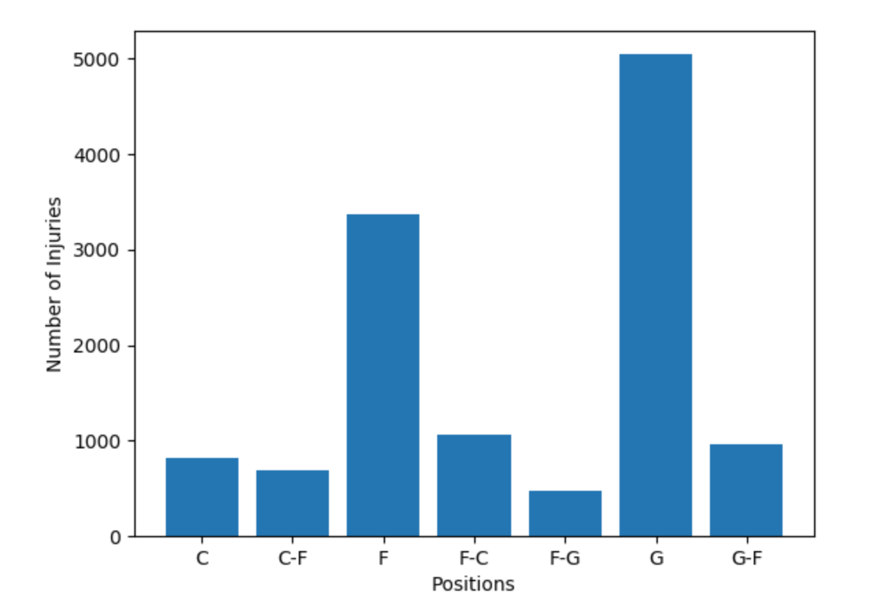
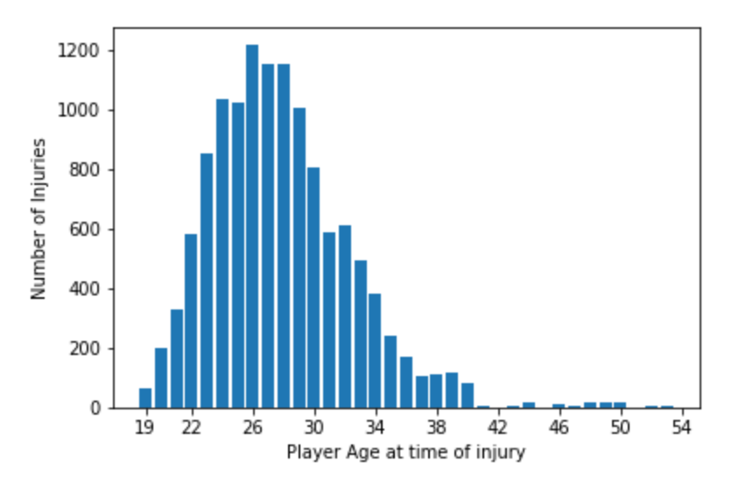
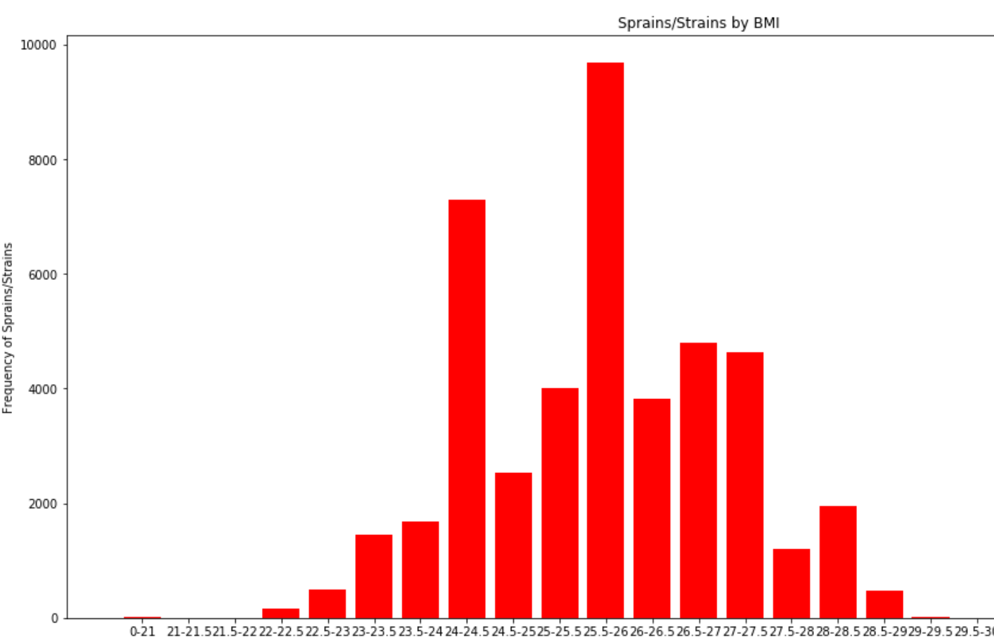
Where We Left Off

Slide 4
Part II
Build out all the possible graphs from the original dataset
Add in injury stats for the 2019 season
Add in the 2019 rookie roster
Can we predict injuries in the 2019 rookie class?
Tools: Pandas, ML, HTML, Matplotlib

Slide 5
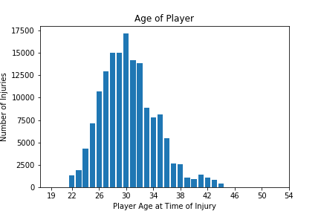
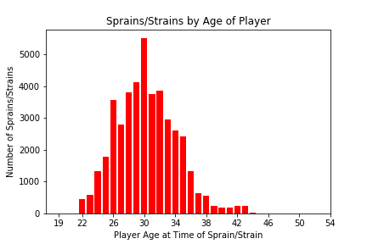
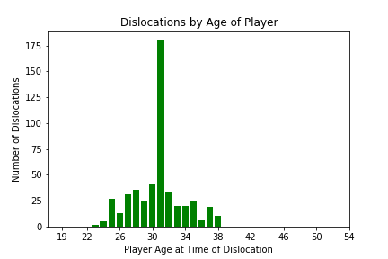
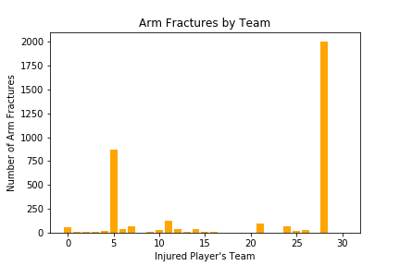
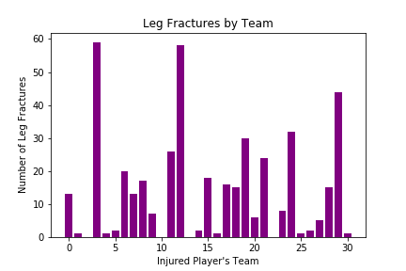
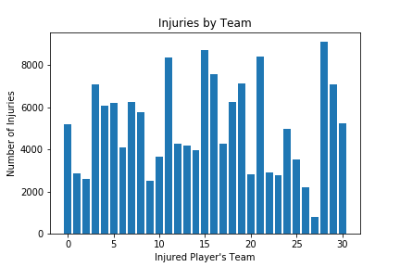
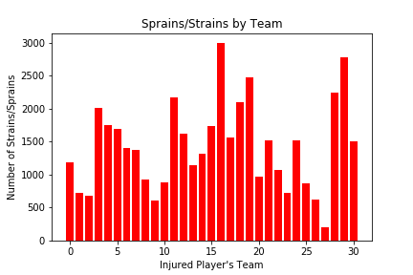
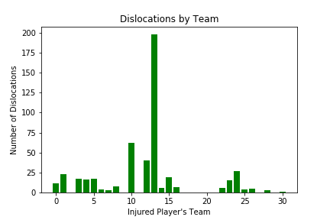
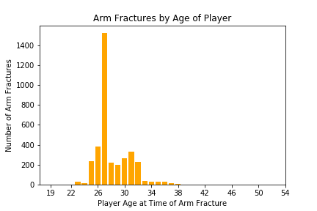
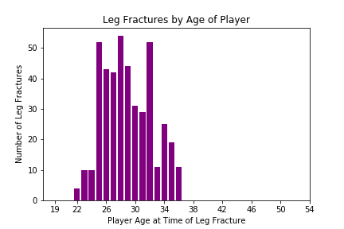
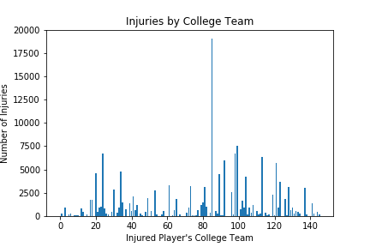
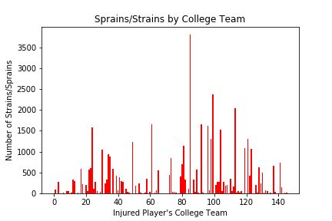
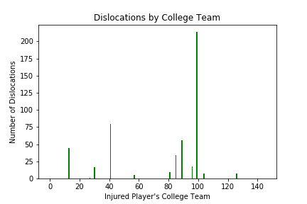
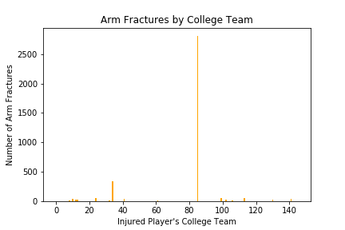
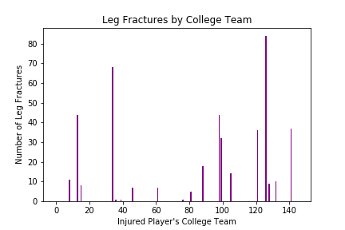
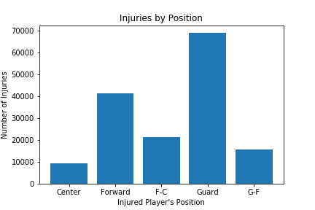
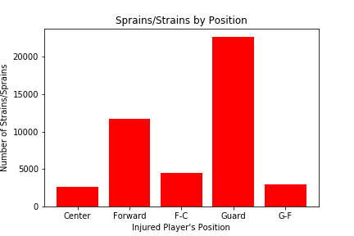
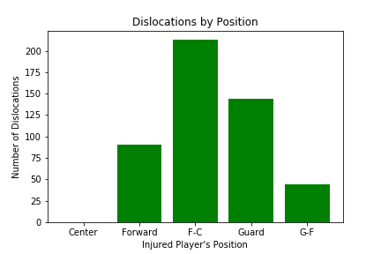
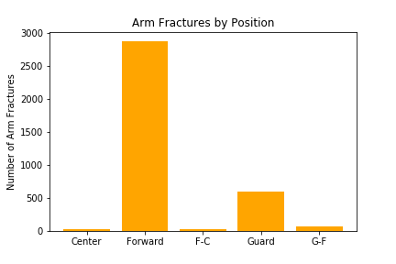
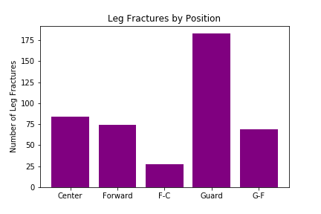

Slide 6
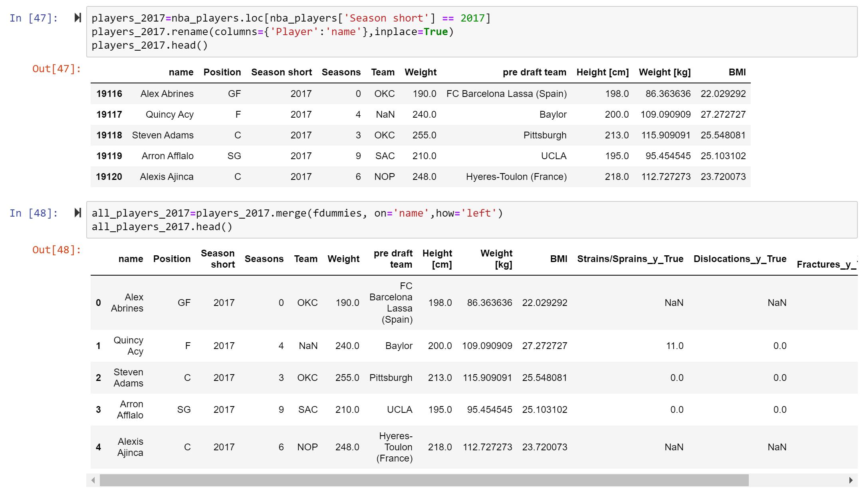

Slide 7
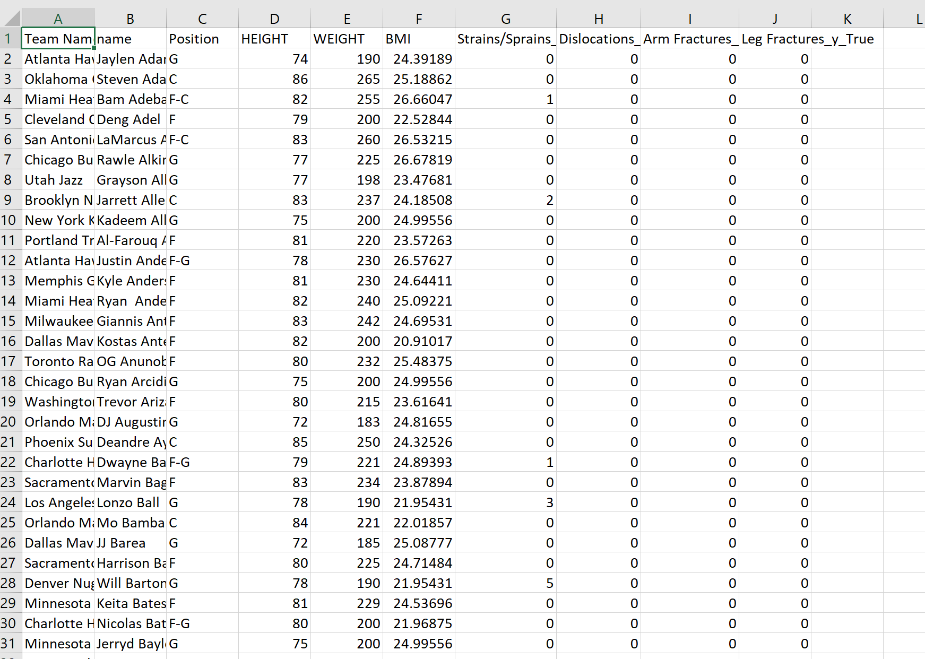

Slide 8
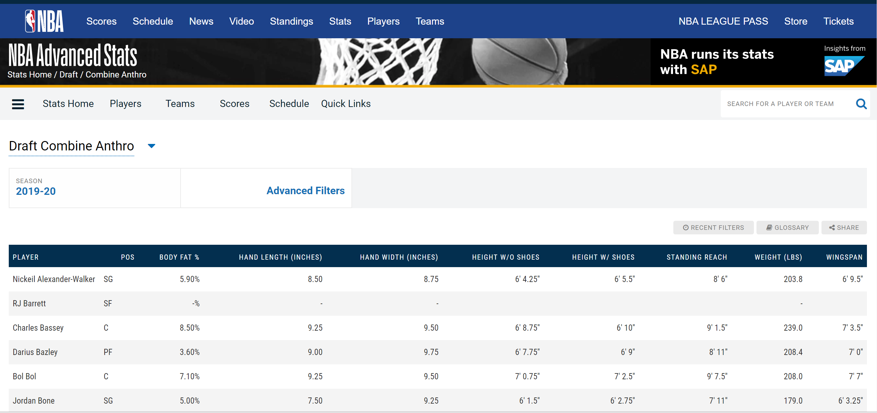

Slide 9
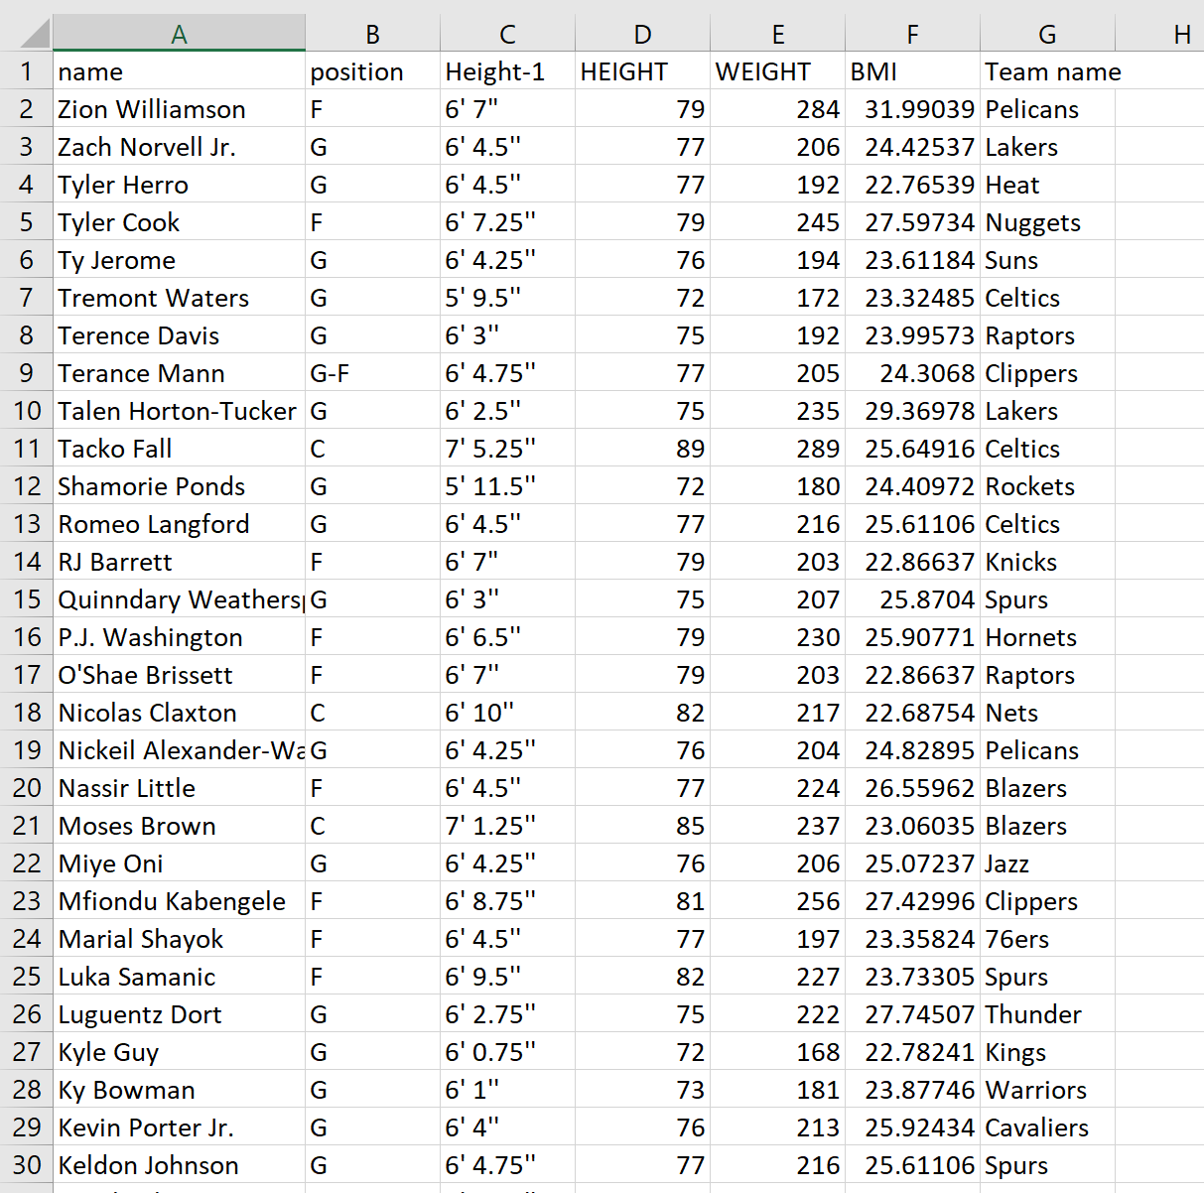

Slide 10
Machine Learning
Combined datasets on matching values
Rookie data was limited-parsed out BMI and position
Resulting dataset had 2 input variables (BMI, position) and provided 4 output variables (sprains/strains, dislocations, arm fractures, leg fractures)
“It’s a doozy”-John Rorie
Random Forest Generator
Multivariate model

Slide 11
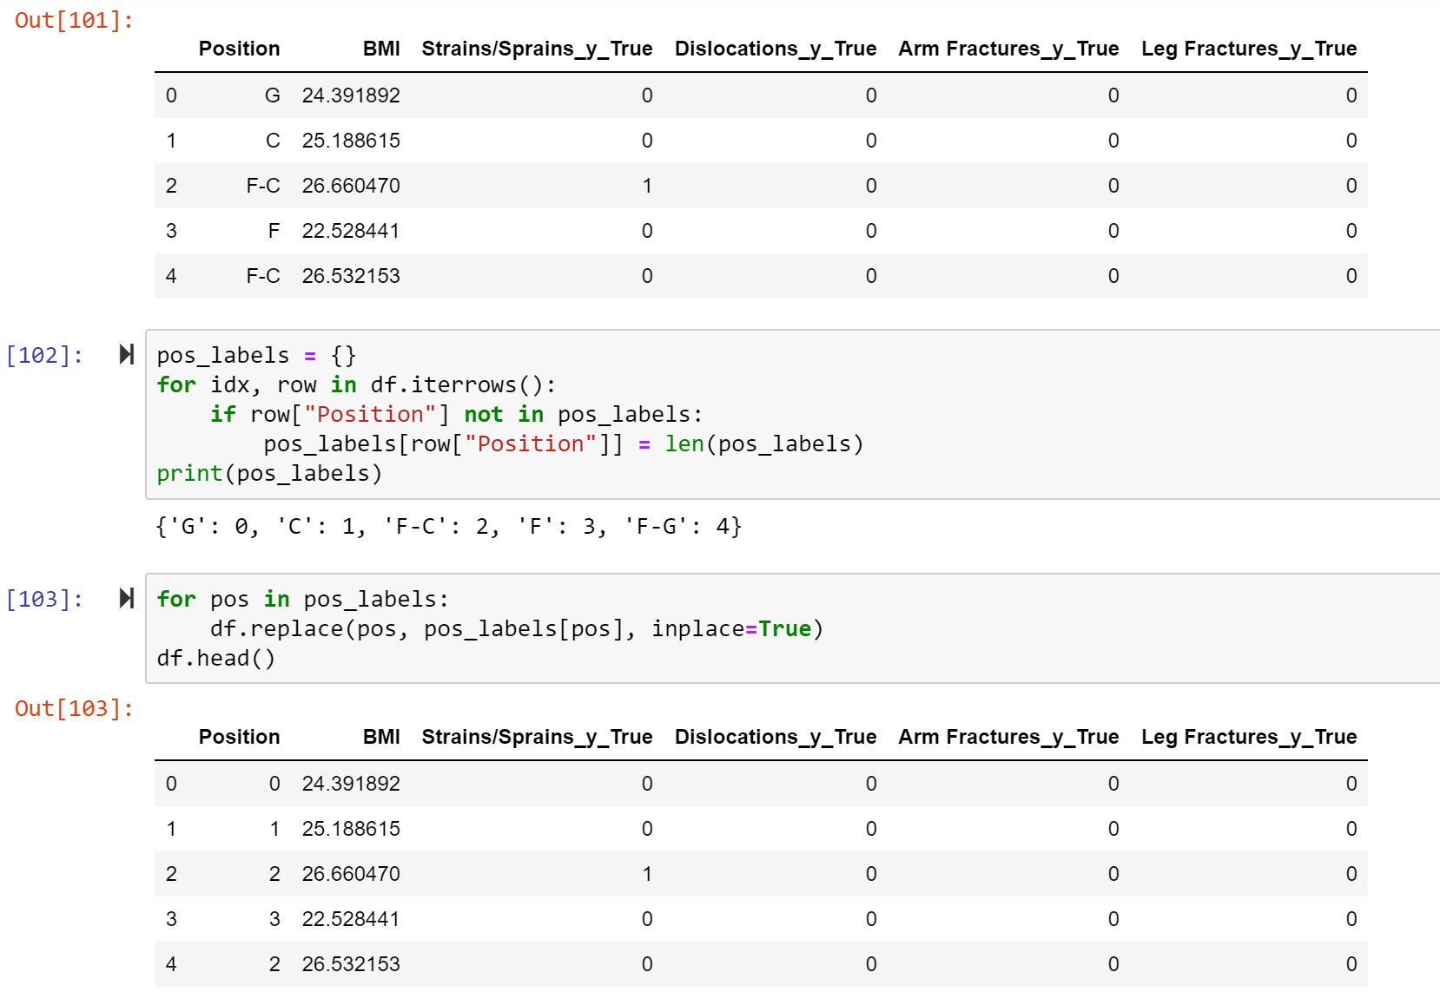

Slide 12
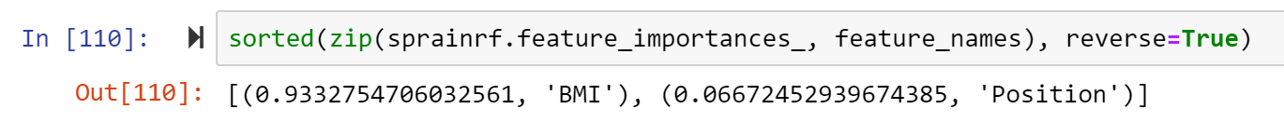
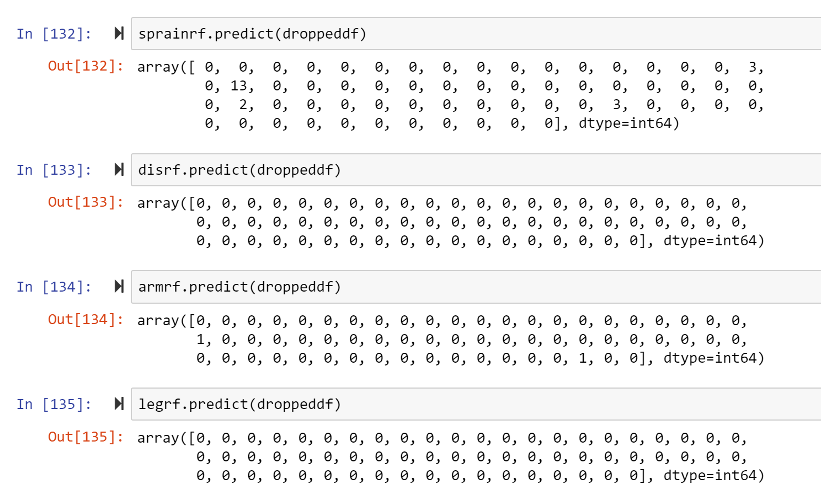
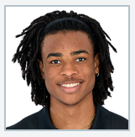
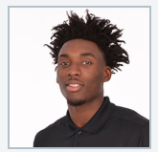
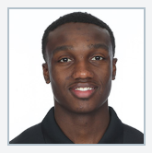
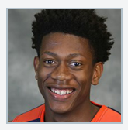
Nicolas Claxton
2nd round, Nets
6’11”, 220
BMI-22.7
Nassir Little
Trail Blazers
6’4”, 224
BMI-26.6
Jared Harper
Undrafted, Suns
5’11”, 175
BMI-23.4
De’Andre Hunter
Lakers
6’7”, 225
BMI-25.3

Slide 13
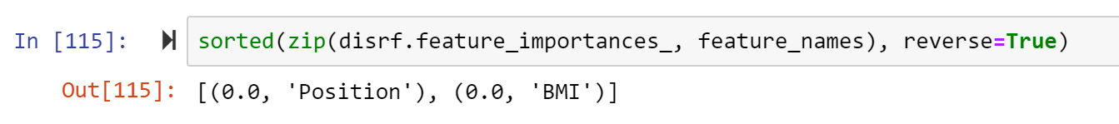



Slide 14
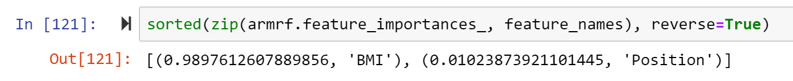
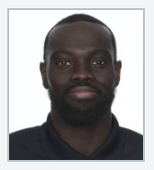
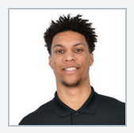
Marial Shayok
76ers
6’6”, 198
BMI-23.4
Brandon Clarke
OKC Thunder
6’7”, 207
BMI-23.3

Slide 15
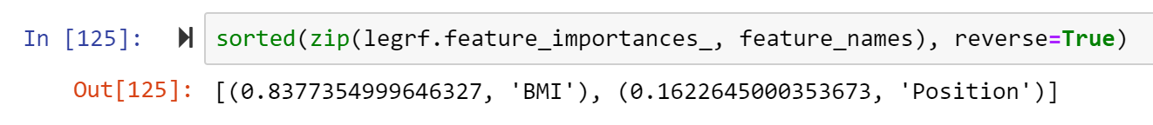

Slide 16
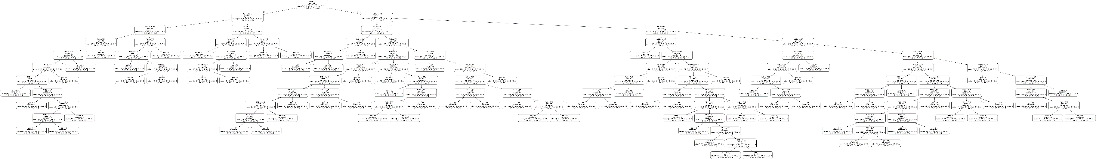
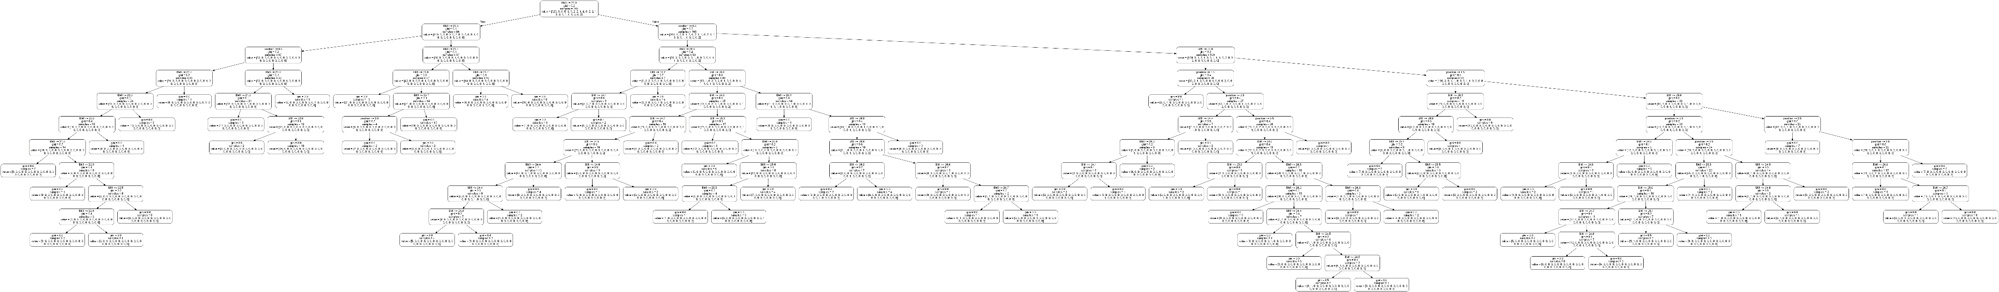
BMI ≤ 23.9 = FALSE

Slide 17

HTML!!!

